Slide 1


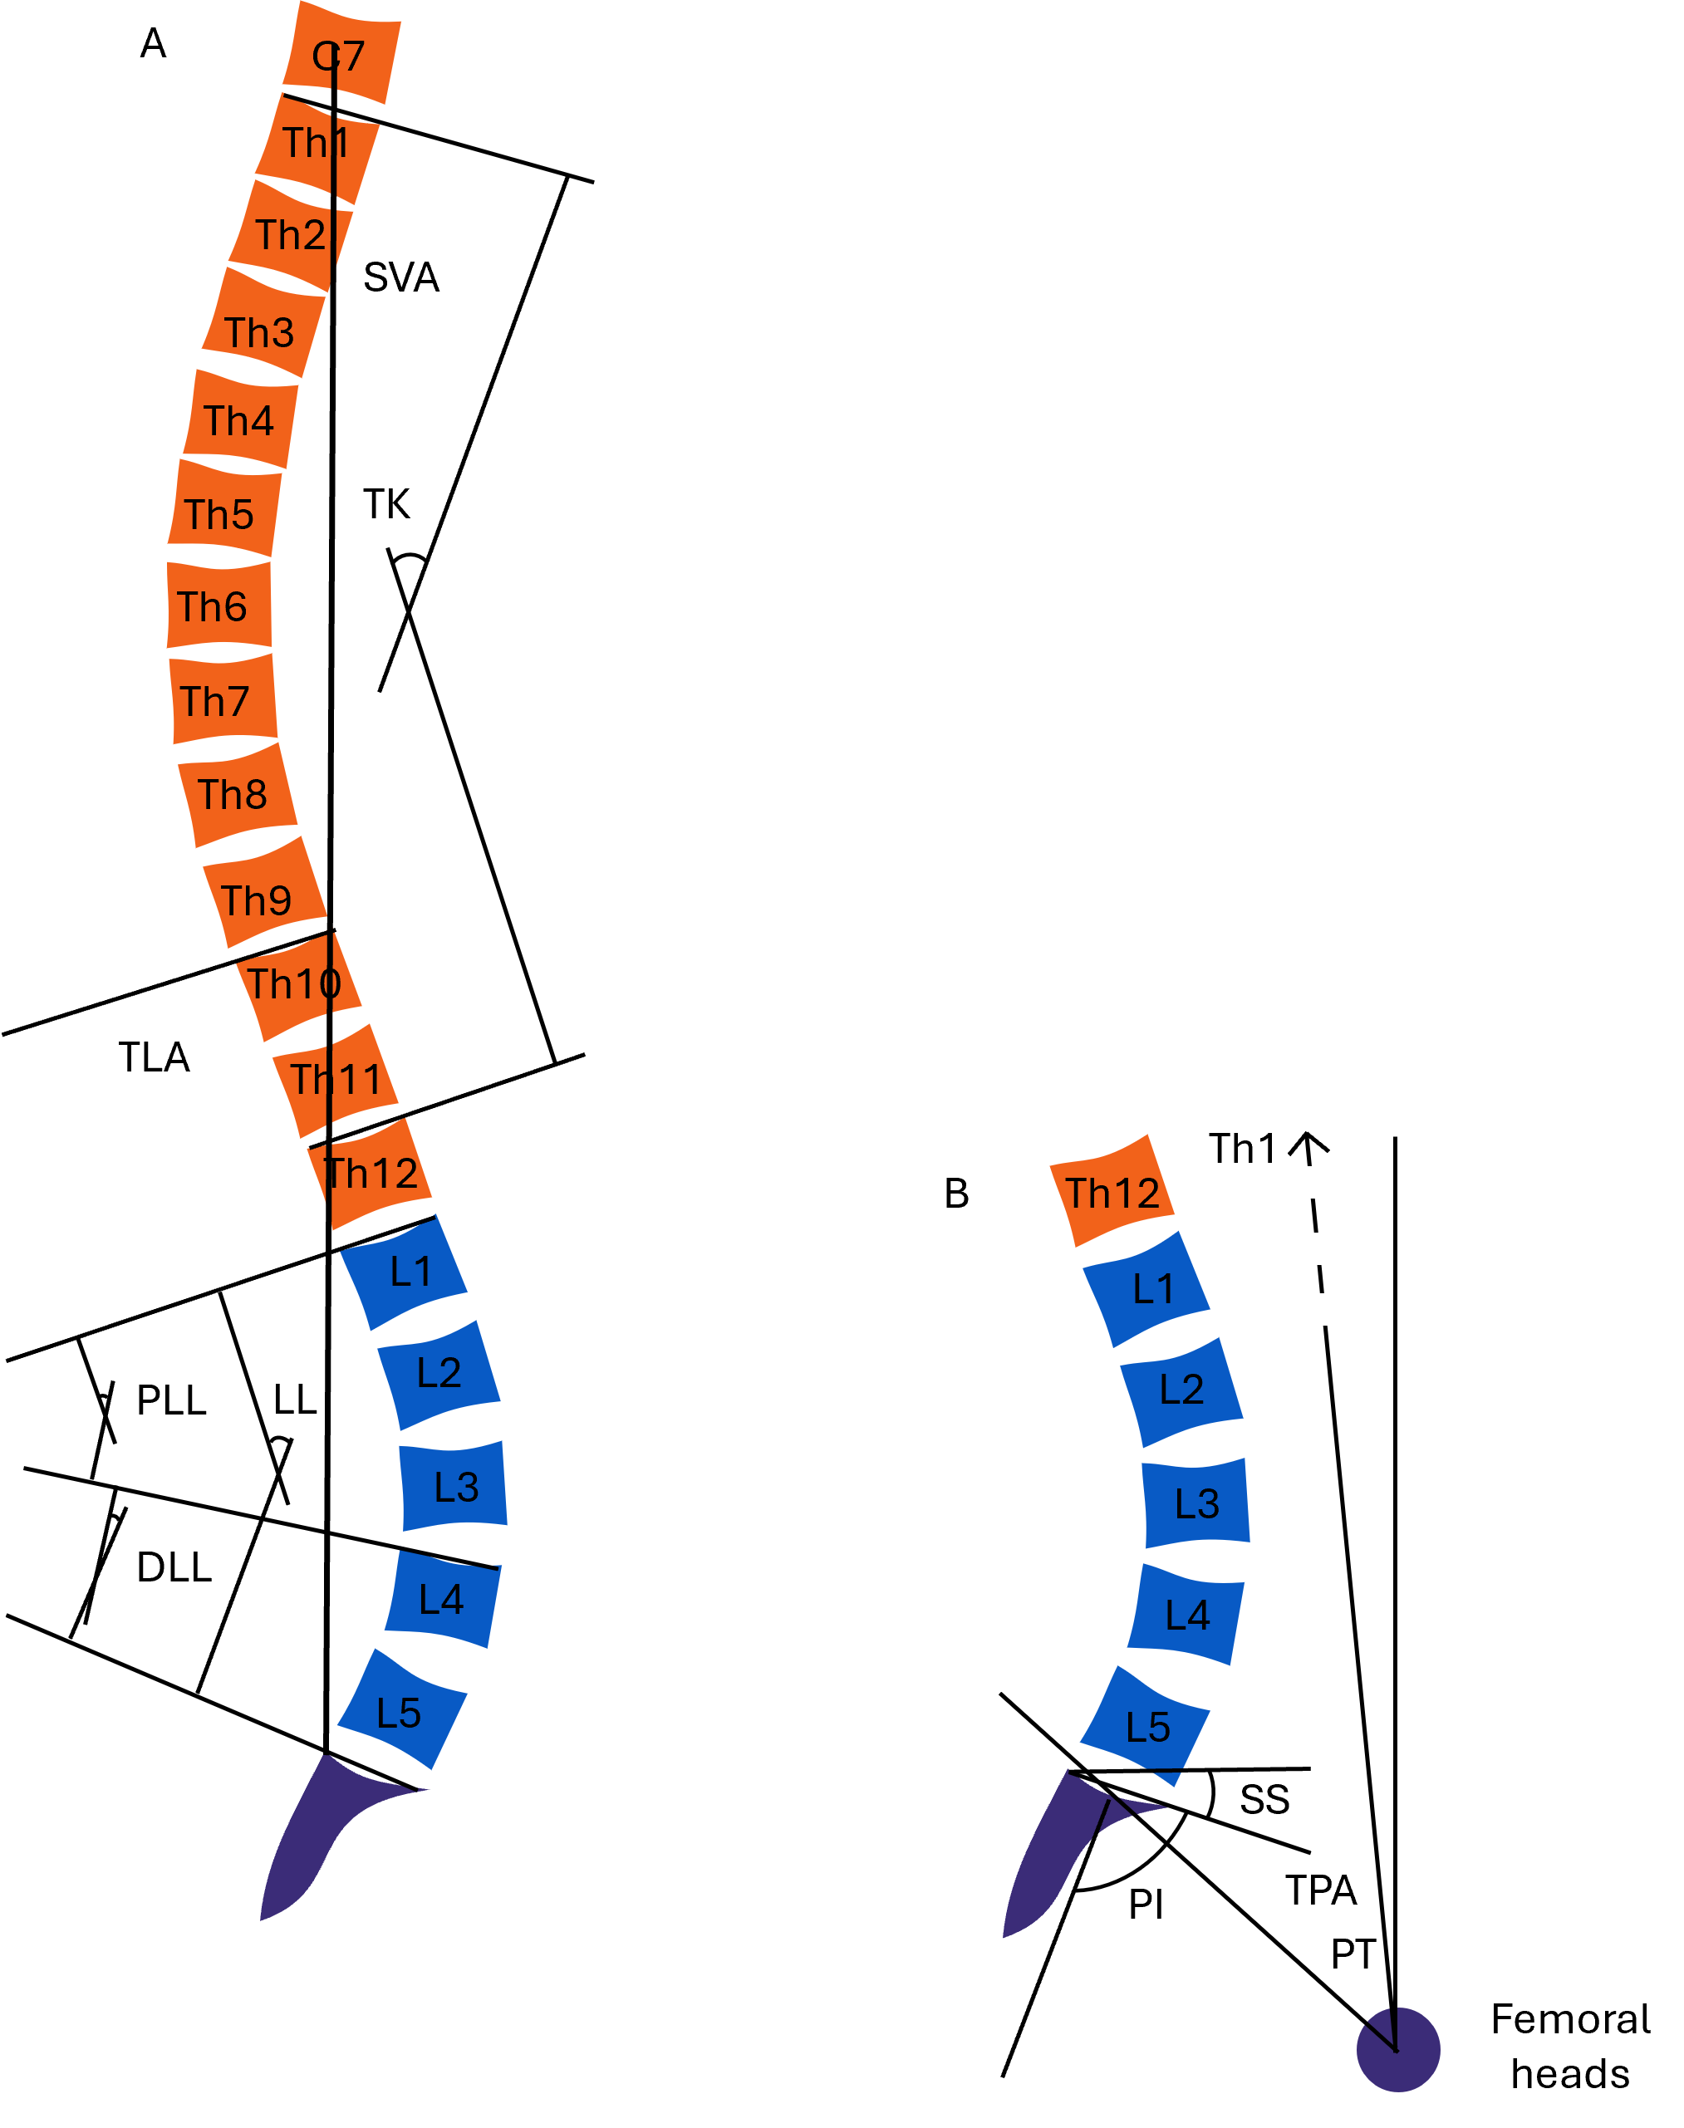
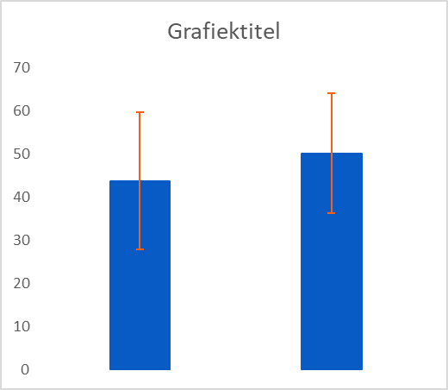
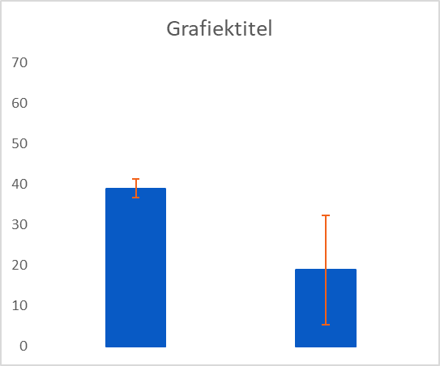
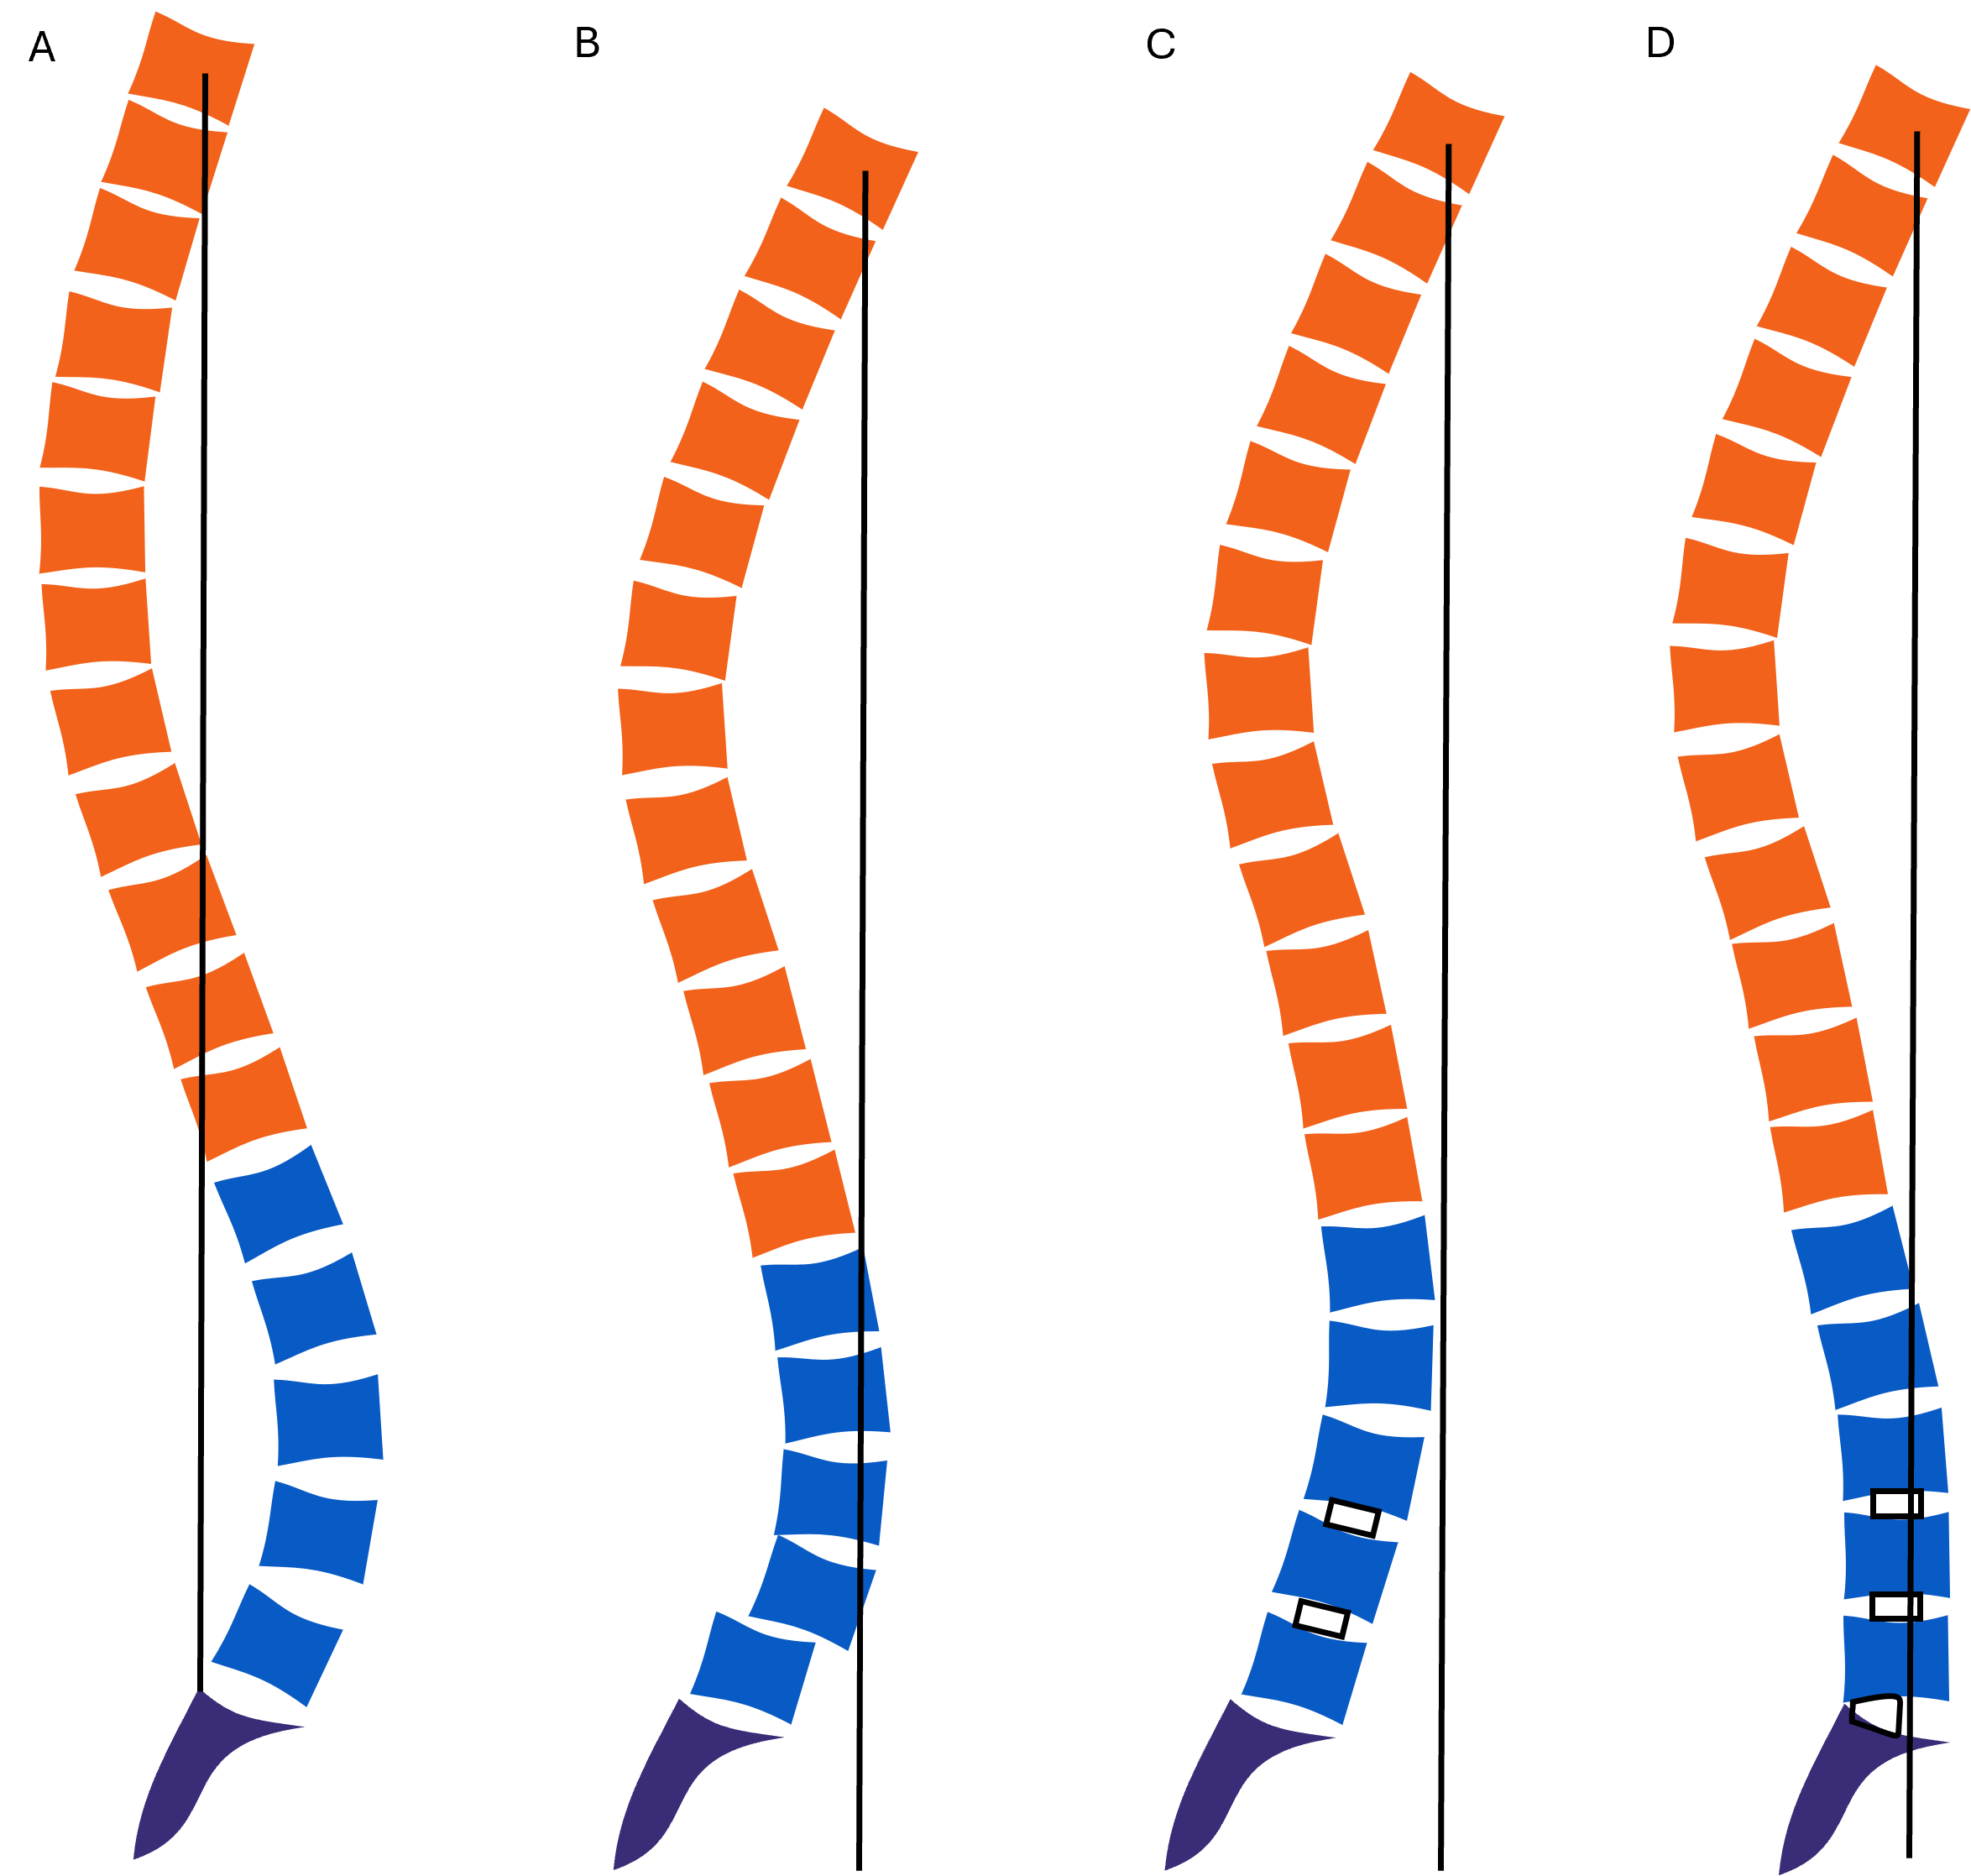
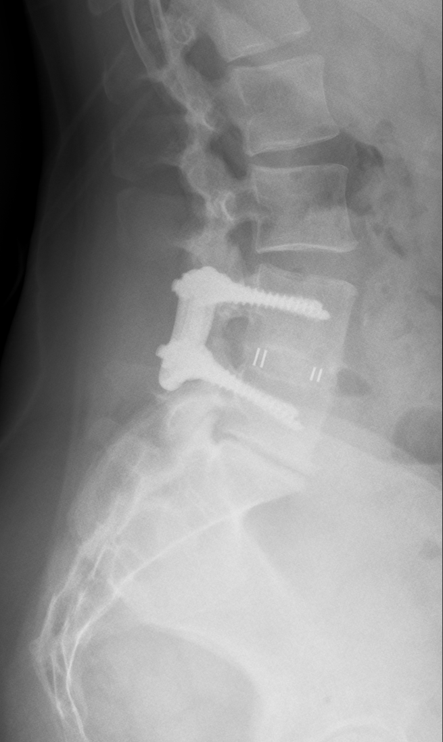
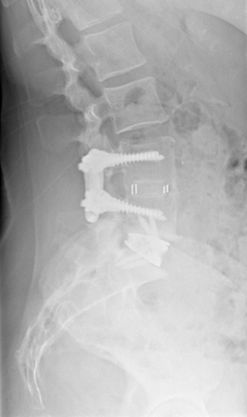



Restoration of sagittal alignment with L5-S1 anterior lumbar interbody fusion in patients with prior lumbar fusions and adjacent segment disease: A retrospective cohort study
R. Bouttelgier¹, D. Vanhauwaert²ʼ³ʼ⁴, W. Maenhoudt²ʼ³, S. Du Four², O. Van Damme², J. Van Lerbeirghe²ʼ³
(1) Department of Neurosurgery, University Hospital Ghent, Ghent, Belgium; (2) Department of Neurosurgery, AZ Delta Hospital, Roeselare, Belgium; (3) Department of Neurosurgery, Jan Yperman Hospital, Ieper, Belgium; (4) Academic Consultant, Department of Human Structure and Repair, Faculty of Medicine and Health Sciences, Ghent University, Ghent, Belgium
Introduction
Figure 1. Sagittal balance parameters
Sagittal imbalance significantly impacts outcomes in adult degenerative spine conditions. Lumbar lordosis (LL) restoration is essential for spinopelvic alignment. Posterior or posterolateral fusions using hypo-lordotic implants can exacerbate spinopelvic imbalance by increasing the already existing degenerative hypo-lordosis. This study examines the impact of L5-S1 anterior lumbar interbody fusion (ALIF) on sagittal alignment in patients with adjacent segment disease following prior posterior or posterolateral lumbar fusions.
Figure 1A demonstrates the calculation of the lumbar lordosis (LL) between the superior endplate of L1 to the endplate of S1. The proximal (PLL) and distal lordosis (DLL) are measured respectively from L1 to L4 and from L4 to S1. The thoracal kyphosis (TK) was defined from Th1 to Th12. The thoracolumbar alignment (TLA) was measured from Th10 to L1. The sagittal vertical axis (SVA) was measured as the horizontal distance between a plumb line drawn from the center of C7 and a plumb line drawn from the posterior superior corner of S1. Figure 1B demonstrates the measurement of the pelvic parameters: the thoraco-pelvic angle (TPA), pelvic angle or incidence (PI), pelvic tilt (PT) and sacral slope (SS).
Methods
Figure 2. Pre- and post- operative lordosis and PI-LL mismatch
This retrospective study included 17 patients with a history of lumbar fusions, treated with L5-S1 ALIF at AZ Delta Hospital between 2019 and 2024. Pre- and post-operative radiographs were assessed for (proximal and distal) LL and sagittal balance parameters. Changes in alignment were analyzed with paired samples t-tests after verification of normal distribution.
Lordosis
PI-LL mismatch
SD
SD
SD
SD
Results
Pre
Post
Pre
Post
Pre-operative LL averaged 43.7° (95% CI [36.1–51.3]) and improved significantly to 50.1° (95% CI [43.5–56.7]; p < 0.05) post-operatively, primarily due to an increased distal LL from 25.5° to 35.2° (p < 0.001). The pelvic incidence – lumbar lordosis (PI-LL) mismatch decreased significantly from 39.0° to 18.9° (p < 0.05), while the sagittal vertical axis (SVA) reduced non-significantly from 97.3 mm to 86.7 mm.
Figure 3. Sagittal (im)balance in degenerative post-fusion can be restored with L5-S1 ALIF
E
E
Discussion
F
F
This study highlights the efficacy of L5-S1 ALIF in restoring lumbar curvature, reducing PI-LL mismatch and improving sagittal alignment in patients with a history of lumbar fusions. Despite the challenges of fixed hypo-lordosis resulting from previous hypo-lordotic lumbar fusions, our findings demonstrate that L5-S1 ALIF can significantly increase LL and reduce forward trunk inclination. Study limitations include a small sample size, missing full-spine radiographic data in a subset of patients and lack of long-term follow-up. Future studies involving larger patient cohorts and extended follow-up are warranted to validate these findings and evaluate their long-term clinical implications.
Figure 3A shows the classical concept of sagittal alignment as the reciprocal balance of TK and LL. Figure 3B demonstrates how degenerative lumbar diseases reduce LL through weakened spinal musculature, increased vertebral wedging and reduced disc health. Posterior or postero-lateral fusions using hypo-lordotic implants can exacerbate spinopelvic imbalance by insufficiently restoring lordosis, as demonstrated in figure 3C. Anterior approaches with the use of hyper-lordotic cages allow effective reconstruction of lumbosacral segmental lordosis, resulting in a relative decrease of forward tilting and restoration of sagittal balance, as displayed in figure 3D. Figure 3E shows a case example of a 44-year-old patient with a history of L4L5 PLIF who developed adjacent segment disease and sagittal imbalance. An L5-S1 ALIF was performed with redistribution of mainly proximal to distal lordosis, a significant reduction of PI-LL mismatch and correction of sagittal balance.
C

